Slide 1
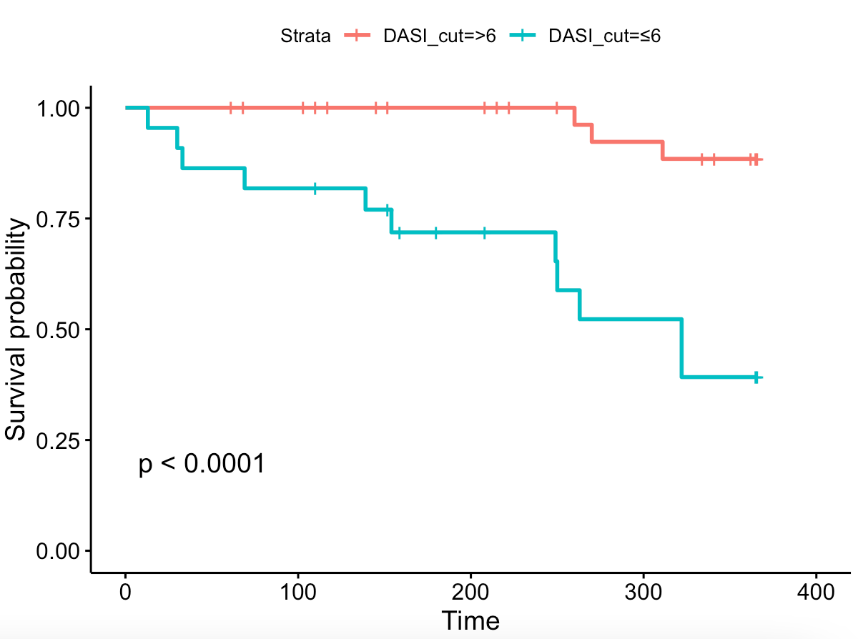
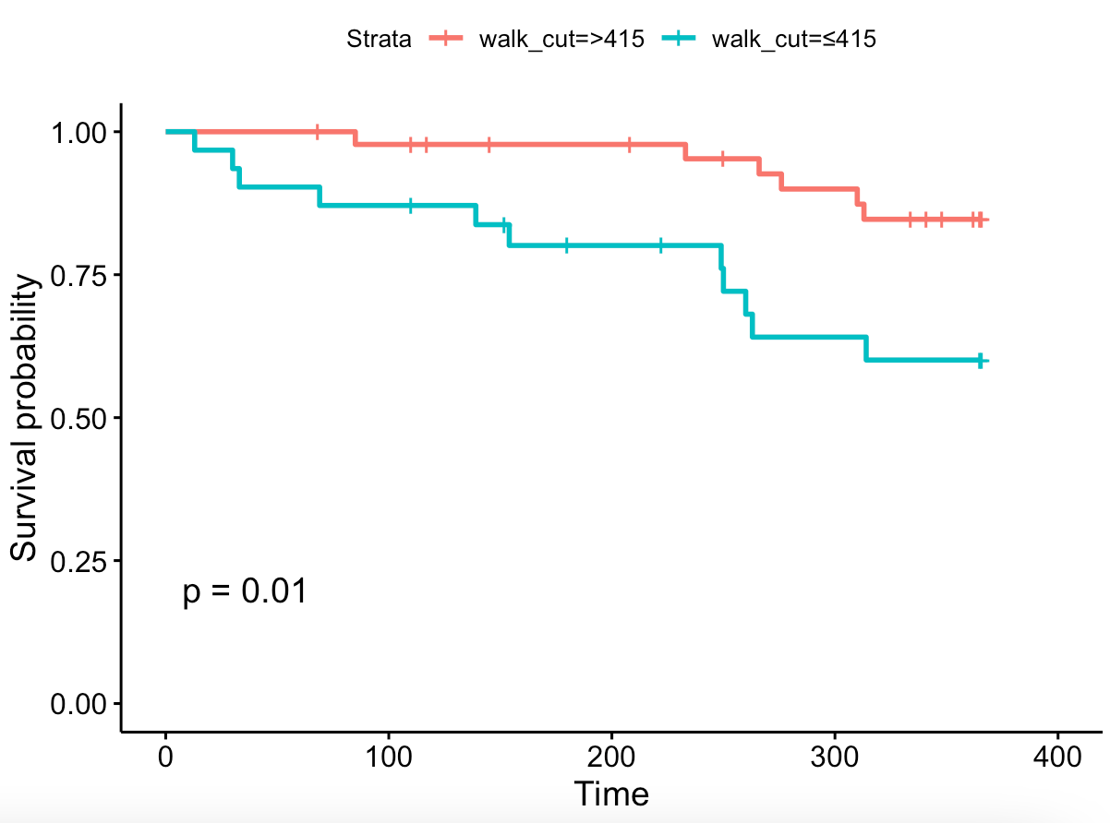
Functional Evaluation of High Risk Patients Presenting for Surgery
Victoria Smith ¹, Dr Myra McAdam ², Dr Martin Shaw ³
Wolfson Medical School, University of Glasgow, G12 8QQ
Department of Anaesthesia, Glasgow Royal Infirmary, G4 0SF
Department of Clinical Physics, Glasgow Royal Infirmary, G4 0SF
Introduction:
Postoperatively, the body experiences a marked increase in oxygen demand and patients with poor cardiorespiratory fitness are less likely to cope with this increase [1]. Formally assessing fitness and identifying patients at high risk of postoperative morbidity and mortality allows for better planning and perioperative care [1]. Cardiopulmonary exercise testing (CPET) is considered to be the gold standard test [2] but this is resource intensive and thus other methods have been developed to assess fitness [3]. Two other commonly used assessment tools are the Duke Activity Status Index (DASI) questionnaire and six minute walk test (6MWT)
Results:
A moderate correlation was found between CPET and DASI (R=0.47) and a weak correlation was found between CPET and 6MWT (R=0.23) ROC curves determined cut-off values to predict 1 year survival as a DASI score of 6.0 METs and a walk distance of 415m from 6MWT Cut-off values were not determined for VO2 peak or AT as they showed poor predictive ability (area under curve of 0.50 and 0.52 respectively) Using the cut-off values determined, Kaplan-Meier plots showed that a DASI score ≤6 significantly decreased 1-year survival (p<0.0001) (figure 1) as did a six-minute walk distance of ≤415m (p=0.01) (figure 2). DASI was a good predictor of survival past 1-year with those scoring ≤6 having decreased survival times (p=0.00099). 6MWT was not a significant test to predict survival extending past 1-year in our population (p=0.15).
Figure 1: Kaplan-Meier curve showing difference in 1-year survival for those scoring above and below the determined DASI threshold of 6.0 METs. P-value was obtained using log-rank testing.
Aim:
To evaluate the use of functional assessment tools that are currently available for use in the Glasgow Royal Infirmary high-risk assessment clinic to predict postoperative mortality by evaluating CPET, DASI, 6MWT and potential confounding factors that may influence outcome.
Conclusions:
In this cohort of high-risk surgical patients, DASI was the most useful assessment tool to predict postoperative mortality. Despite being considered as the gold-standard, CPET was not a useful test, and its utility should be evaluated further to ensure effective clinical practice.
Methods:
Caldicott guardian approval was granted to access relevant patient data. Ethical approval was not required after discussion with the West of Scotland Ethics Committee as this was a service evaluation project. This was a retrospective analysis of prospectively collected data for 123 patients who attended the high-risk assessment clinic at Glasgow Royal Infirmary. Pearson’s correlation method was used to assess if a correlation existed between CPET, DASI and 6MWT. Cut-off values for the exercise tests were determined by plotting receiver operator characteristic (ROC) curves for the exercise tests against 1-year survival. Survival analysis was carried out for both 1-year and extended survival by plotting Kaplan-Meier curves and producing Cox proportional-hazard models.
Acknowledgements:
This research was carried out as part of a BSc (MedSci) at the University of Glasgow. I would like to thank Dr Rachel Kearns, BSc co-ordinator, for guidance during this project.
Figure 2: Kaplan-Meier curve showing difference in 1-year survival for those walking further or less than the determined six minute walk distance threshold of 415m. P-value was obtained using log-rank testing.
References:
Struthers, R., et al., Assessing fitness for surgery: a comparison of questionnaire, incremental shuttle walk, and cardiopulmonary exercise testing in general surgical patients†. BJA: British Journal of Anaesthesia, 2008. 101(6): p. 774-780.
Levett, D.Z.H., et al., Perioperative cardiopulmonary exercise testing (CPET): consensus clinical guidelines on indications, organization, conduct, and physiological interpretation. Br J Anaesthesia, 2018. 120(3): p. 484-500.
Riedel, B., et al., A simplified (modified) Duke Activity Status Index (M-DASI) to characterise functional capacity: a secondary analysis of the Measurement of Exercise Tolerance before Surgery (METS) study. British Journal of Anaesthesia, 2021. 126(1): p. 181-190.

